Slide 1
SAGIA East Coast Economic Roundtable
New York, March 3 2020
With His Excellency Ibrahim AlOmar, Governor of SAGIA
9

Slide 2




Target sectors
“Finance themed” event comprising C-level players, with main focus on 4
key economic sectors:
Healthcare & Life Sciences
Financial
services
Energy
Real estate
10

Slide 3
New York roundtable plan
DRAFT
“Finance themed” roundtable and 1:1 discussions with key players in the financial sector and select industry participants
March 3rd March 3rd , 4th
3 SECTORIAL Lunch 1:1 MEETINGS BREAKOUTS
ROUNDTABLE
Presentation:
Invest Saudi value proposition
Select case studies of recent “success stories”
Financing opportunities in
3 sectors:
HC & LS Energy
Networking opportunity with Saudi officials and discussions with SAGIA staff
Select MD’s and executives from focus sectors
SAGIA pipeline company
executives
Economic development organizations
Real Estate
Financial services

Slide 4
DRAFT
March 3rd and 4th agenda (New York)
March 3rd
Program/ session
9:00 – 9:30 AM | Networking breakfast
9:30 – 10:30 AM | Plenary session:
 | Invest Saudi value proposition
 | Saudi reforms presentation by Assistant Minister of Commerce and Investment, President of National Competiveness Center of Saudi Arabia
10:30 AM – 12:00 PM | sector breakout:
 | Healthcare and Lifesciences
 | Energy
 | Real estate
 | Financial services
12:00 – 1:00 PM | Closing lunch
01:00 – 04:30 PM | 1:1 meetings
12

Slide 5


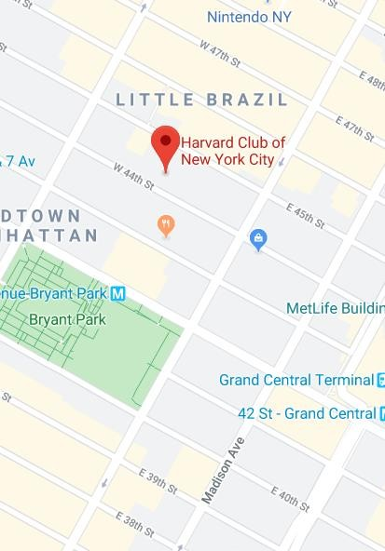


Venue: Harvard Club of New York City -
35 W 44th St, New York, NY 10036
DRAFT

